Slide 1
Anik Chandra Bormon Batch: 23 Roll:01-023-04
Project on
TRANSCOM BEVERAGES LTD.

Slide 2

Welcome to my Presentation

Slide 3
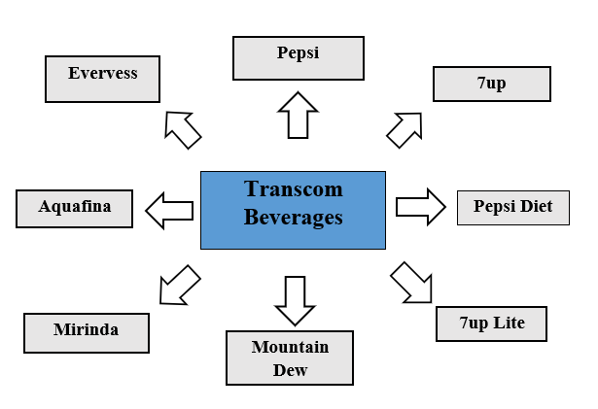
Our Products

Slide 4
Business policy
Use Brand Name
Training Help
Marketing Help
Knowledge Sharing
Technical Help

Slide 5
Marketing Policy
Advertising
Promotion
Public Relation

Slide 6
Production Strategy
Forecasting of production based on order
Four-step production process
Number of production plants
Production and distribution diagram

Slide 7
Rewards and Recognition
Bottle of the year (2009 & 2016)
Best Plant Team (2014)
PepsiCo AMENA Silver Food Safety Award (2016)
Celeb Bradham Bronze Award (2016 & 2018)
Celeb Bradham Silver Award (2017)
Chairman’s Circle of Champions (2017 & 2018)
Best of The Best Platinum Award

Slide 9
Thank You

